Slide 1
MEMORY TRAINING FOR THE ELDERLY
Mgr. Vera Suchomelova, Th.D
v.suchomelova@centrum.cz

Slide 2
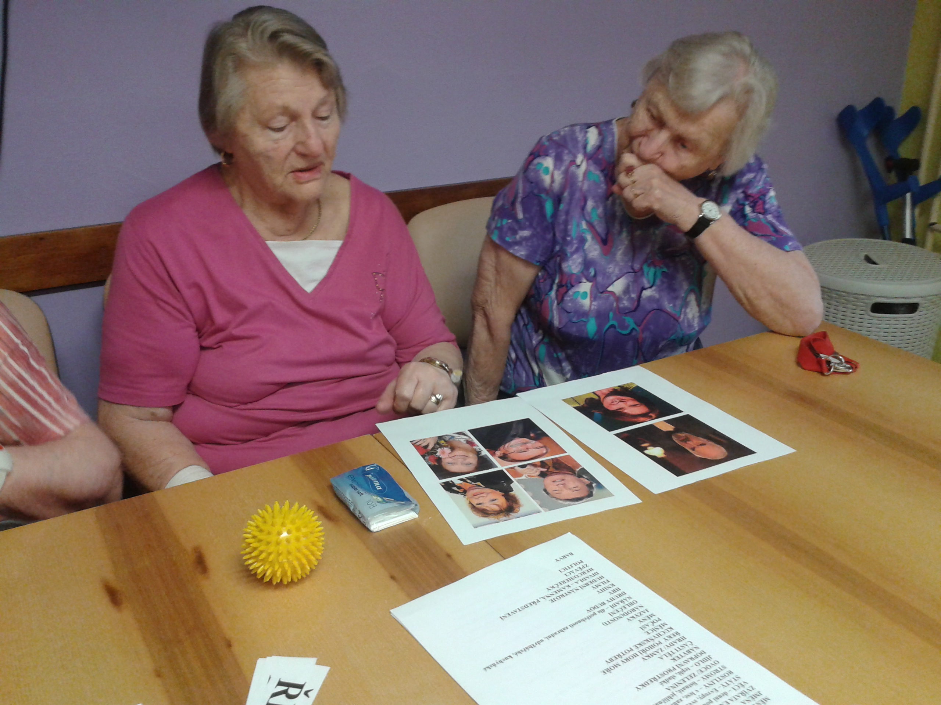
Memory Training
A way to support your memory not only in old age.
A great kind of group or individual activity you can do with the elderly in lifelong learning courses, in nursing homes or wherever.

Slide 3
Overview
How does the memory work?
Which brain abilities are important for a “good memory”?
Are all the memory difficulties in old age related to dementia?
How can the elderly train their memory every day?
What is the benefit of group memory training?

Slide 4
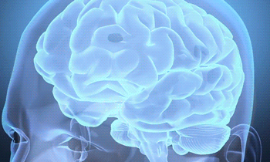
What is memory?
Memory is the brain's ability to encode, store and retrieve information

Slide 5
The Memory Process
Encode
Get the information into your brain through the senses
Store
Retain the information in long-term memory
Retrieve
Recall the information from long-term memory

Slide 6
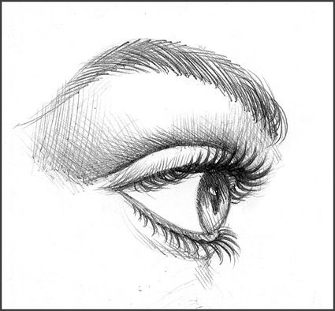
The Memory Process
The information is transferred…
From perception
to sensory memory
to short-term memory
to long-term memory
Sensory Memory
Short-term Memory
Long-term Memory
Implicit Memory
Sémantic M
Episodic M
Explicit Memory
Procedural M

Slide 7
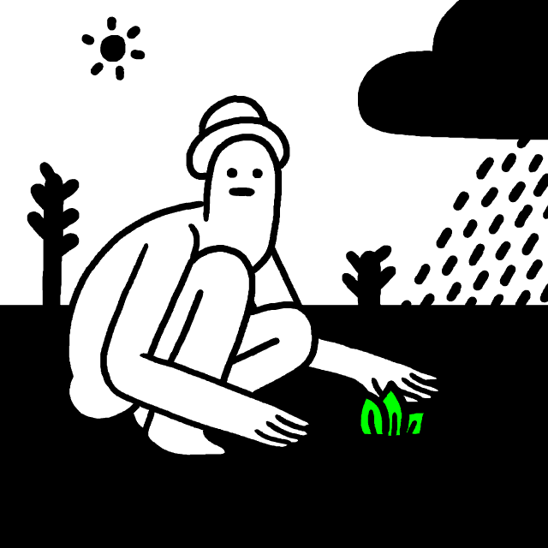
Sensory Memory
Sensory memory is the ability to retain stimuli received through the five senses of sight, hearing, smell, taste and touch.

Slide 8
Sensory Memory
It takes less than a second.
Most of the information disappears immediately.
Only information important enough to pay attention to are transferred to short-term memory.

Slide 9
Attention! Attention! Attention!
When you do not pay attention, you cannot remember.
When you do something automatically, subconsciously, there is no information to recall.
Not “bad memory“ but “poor attention“.

Slide 10
Short-term Memory
Short-term memory holds a small amount of information for a short period of time.

Slide 11
Short-term Memory
Ultra-short term memory (few seconds)
Short-term memory (few hours)
Limited capacity (5 +/- 2 items)
Space for remembering and processing information at the same time

Slide 12
Consolidation
Only the important information is transferred to long-term memory
It happens through the process of consolidation
Consolidation involves rehearsal and meaningful associations
There is the right time for mnemonics to remember better!

Slide 13
Mnemonics
Mnemonics are techniques or strategies to help you to remember better.
Mnemonics make the information more memorable (organized better, unusual, funny…).
Mnemonics help you to remember longer pieces more easily.

Slide 14
Mnemonics – examples
Acronyms: HOMES (Huron, Ontario, Michigan,Eirie, Superior) ROY G. BIV (colors of the Rainbow)
Method of loci: information is tied to a specific place
Chunking: long information is separated to short units
Meaningful categories: information are separated in a logical order
https://en.wikipedia.org/wiki/Mnemonic

Slide 15
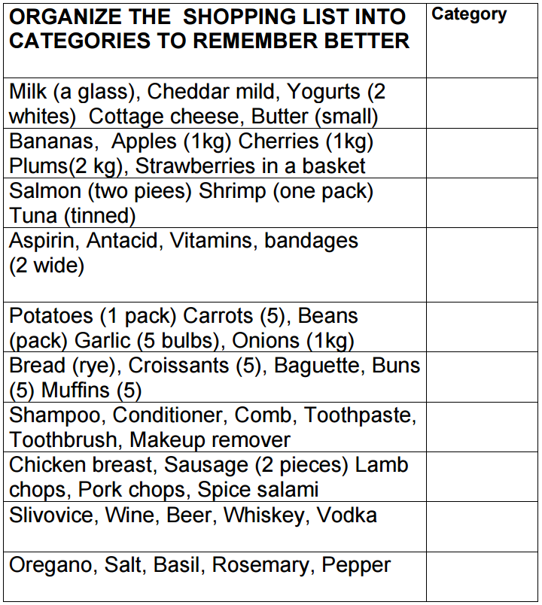
Daily exercise:
Imagine all the items.
Make a mental picture.
Is it in a box… in a jar?
The more detailed the better.
List the items in a logical order.
Try to recall the items looking only at the category.

Slide 16
Long-term Memory
Long-term memory is storage of unlimited information for a long period of time (forever).

Slide 17
Long-term Memory Like a Library
To remember well means not only to have the information in your long-term memory but also to find it when you need it.
There are A LOT of books in your „brain library“.
Help your brain to store the important information the right way.

Slide 18
Remember Better
Always connect the new information to some other things you already know.
Mnemonics help you both to store and to recall the information.
Support the information conciously by tastes, smells, sights, sounds, moods (sensory and emotional triggers).
https://www.youtube.com/watch?v=mgHxmAsINDk
Emotional Trigger

Slide 19
Parts of Long-term Memory
Explicit Memory: WHAT?
Semantic (facts, knowledge)
Episodic (events you have experienced)
Implicit Memory: HOW?
Procedural (motor and cognitive skills you use unconsciously like riding, walking up the stairs, speaking etc.)

Slide 20
Neural Network – Information Highway
The neural network is the „brain’s information highway.“
The neurons communicate with one another through synapses.
The more experiences and learning, the more synapses and stronger network.

Slide 21
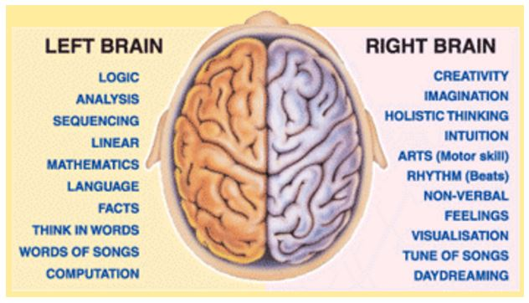
Brain Hemispheres in Process of Learning
http://ucmas.ca/our-programs/whole-brain-development/left-brain-vs-right-brain/

Slide 22
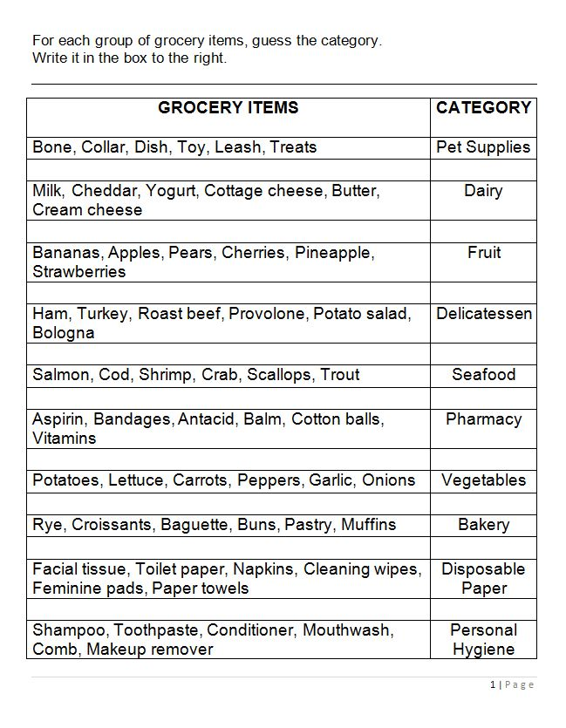
What helps you to remember better?
Concentration
Association
Logical system
Visualization
Imagination

Slide 23
And what else?
Sleep enough
Keep your mind clear
Manage your time
Develop both the left and the right sides of your brain

Slide 24
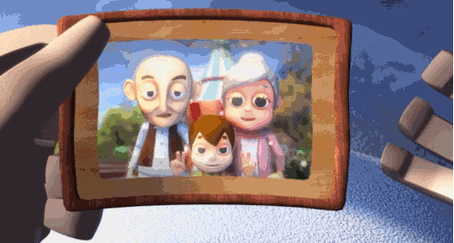
Normal versus Pathological Aging
It is very important to know when to tell the doctor about memory concerns.
It is equally important to know that forgetting someone's name does not necessarily mean dementia.

Slide 25
FreeDem Video
Watch the video
http://freedemliving.com

Slide 26
Normal versus Pathological Aging
„Normally“ aging seniors
Unable to remember details of conversation or events from the past
Unable to remember names of acquaintances
Forget things and events occasionally
Difficulty finding words occasionally
They worry about their own memory, but relatives do not
Seniors with dementia
Unable to remember from a few minutes before
Unable to remember names of family members
Forget things and events frequently
Difficulty finding words often, use many wrong words
They do not worry about their own memory, but relatives DO

Slide 27
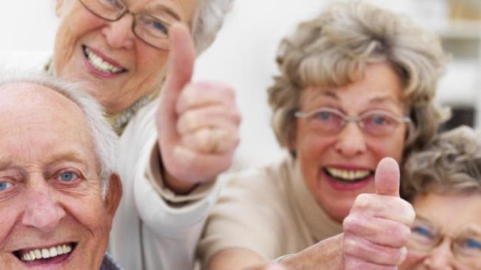
Benefits of Group Memory Training
Support from a social network
Sharing common interests
Making friends, having fun
Increased self-confidence
More participation in group discussion
Feel support from a lecturer

Slide 28
When you train memory with the elderly
Respect their dignity. They may be old but they can be experts in some areas.
Involve their life experiences in your lesson.
Avoid embarrassing situations.
Appreciate every little success.
Realize and accept that they need more time to think about the problem.

Slide 29
When you train memory with the elderly
Expect some sensory difficulties and adjust (bigger letters, good acoustics, well-lit room, etc.).
Make your memory training colorful, train different parts of memory.
Make it not too easy and not too difficult.
Pay attention to all of the group members, not only the „active“ ones.
Be friendly, be kind, be creative but mainly be yourself.

Slide 30
Some tips for your daily memory training
Use your „weaker“ hand for unlocking the door etc. mixing dough, typing, brushing teeth, drawing, writing
Look at familiar places in a new way, like a tourist. Pay attention to the individual buildings, bushes, trees.
Support your sensory memory. Pay attention how you feel things when you touch them, how they smell, look.

Slide 31
Daily Memory Training
Read actively with understanding. Tell your friends about the stories.
Include mnemonics in your daily life (e.g. try to remember the shopping list)
Make your daily plans. Be happy with each step.

Slide 32
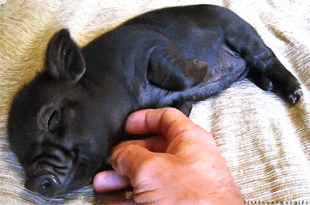
And what is very important…
Focus more on the positive things. There are always some things in your life you can be grateful for.

Slide 33
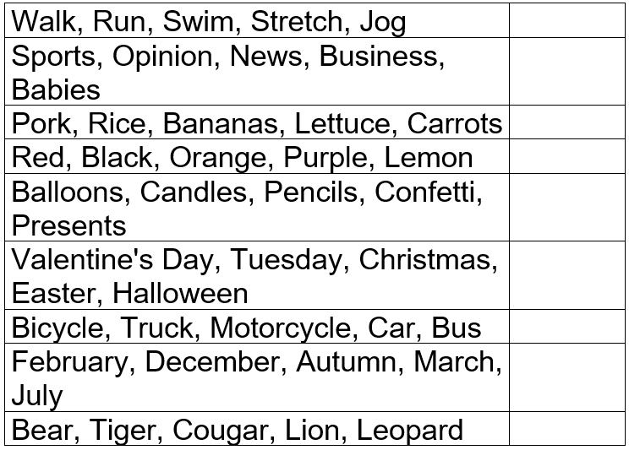
What does not belong to…and why?
An example of how to support sémantic memory

Slide 34
What doesn´t belong to…a key

Slide 35
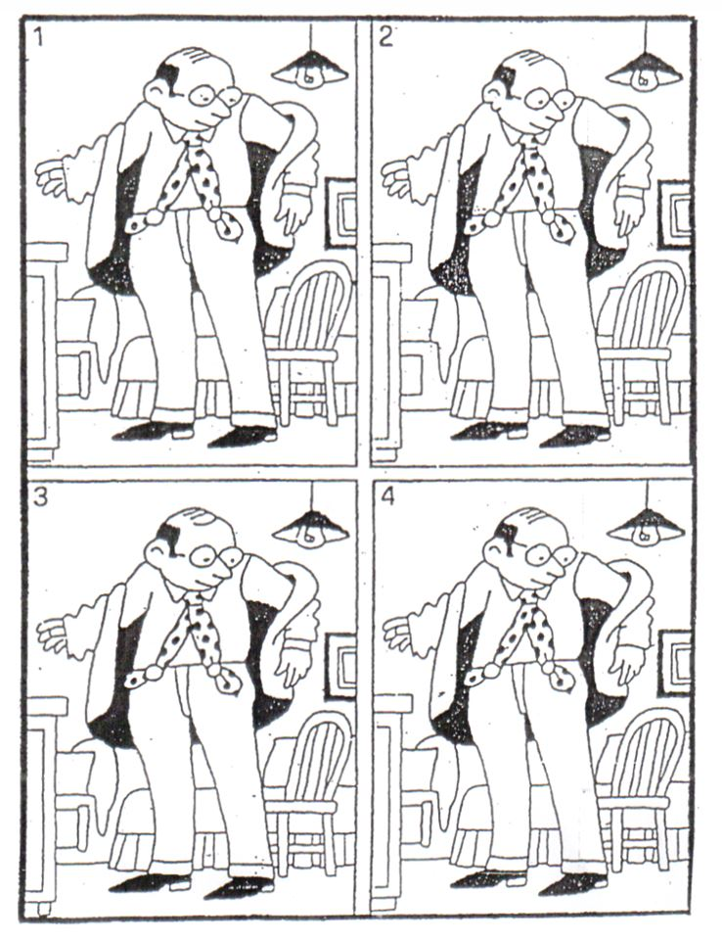
Concentration
The artist made the first picture. Then he tried to make copies.
He was not succesful. Each copy (2,3,4) committed three serious mistakes.
Discover them.

Slide 36
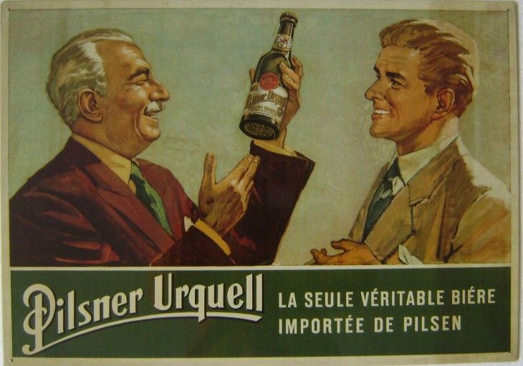
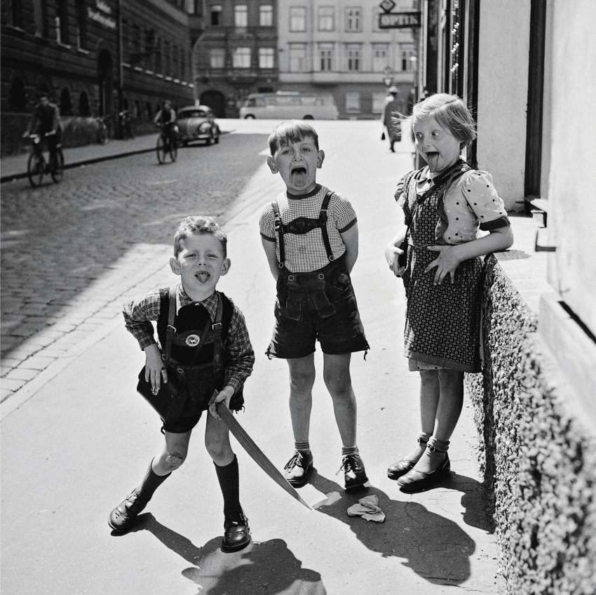
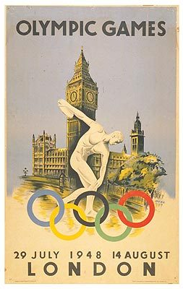
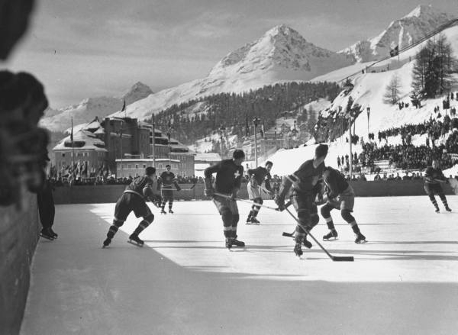
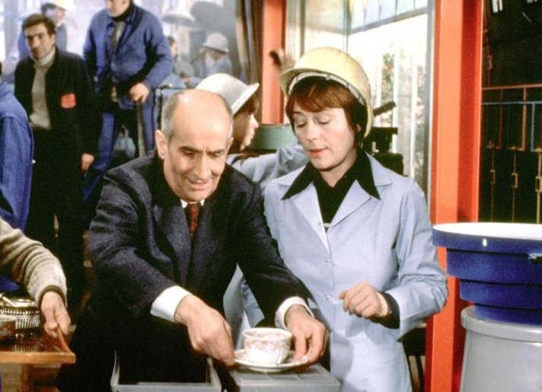
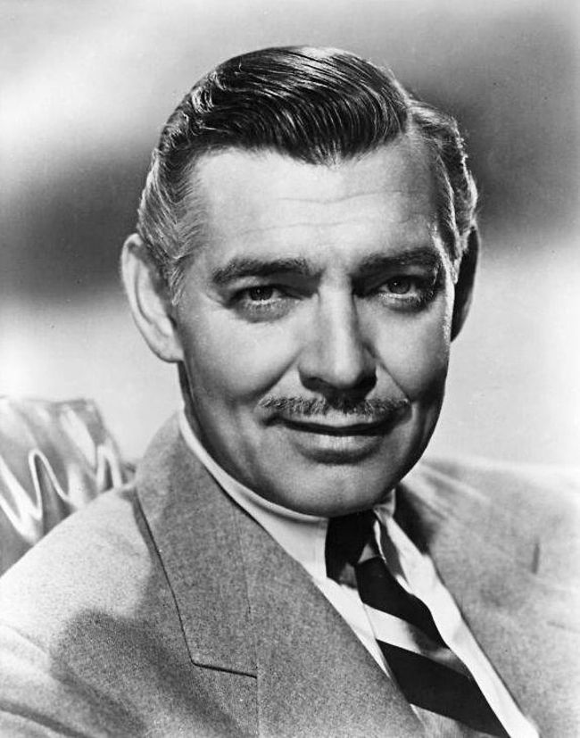
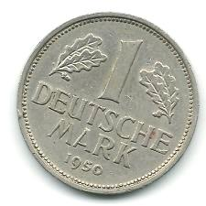
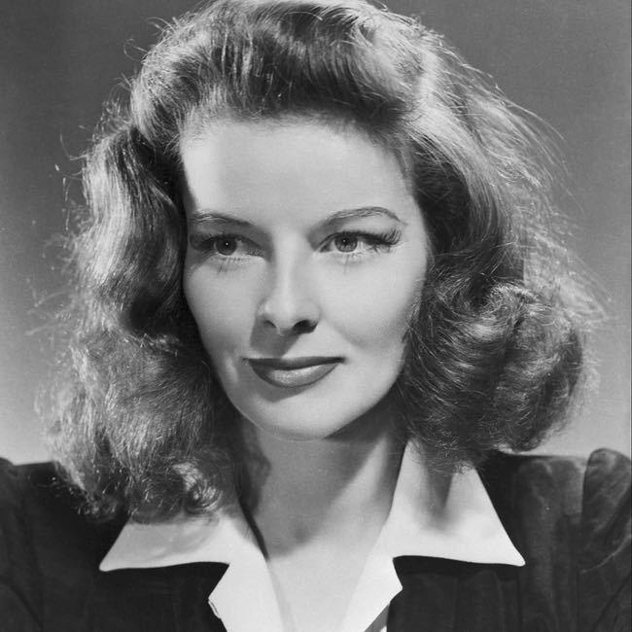
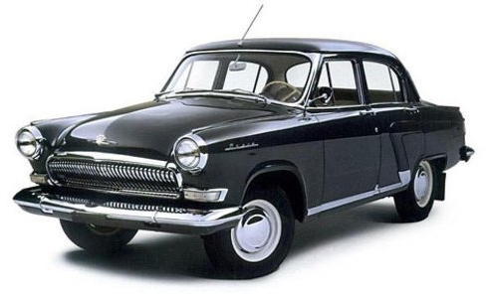
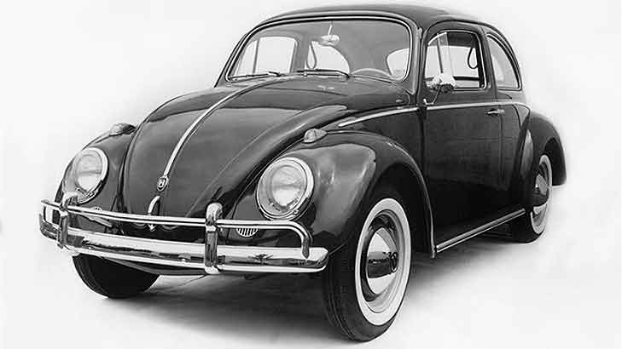
Do you remember? (reminiscence)

Slide 37
Some other tips for exercises…
Concentration: Editor’s reading (in one paragraph count all letters A, TE)
Association: What things are yellow? What green plants can you eat?
Visualization: You are looking up at the branches full of green leaves. What do you see?
Imagination: For what can you use an empty milk bottle or a walnut shell? The more creative the better!
Procedural memory: Write your favorite recipe from memory. What´s important to keep your clothes looking good for a long time? (a good activity for residents of nursing homes who no longer cook or wash clothes for themselves.)

Slide 38
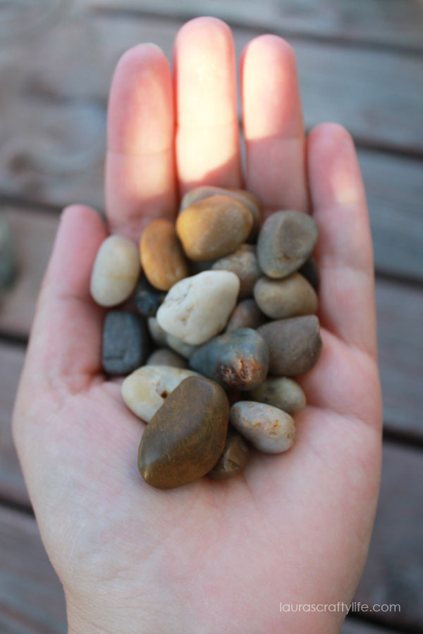
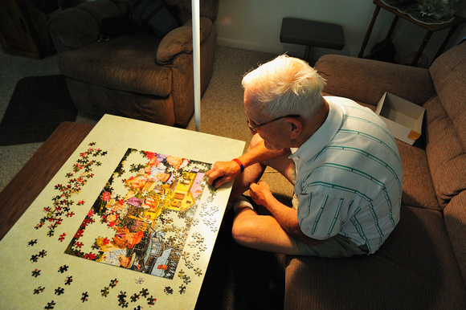
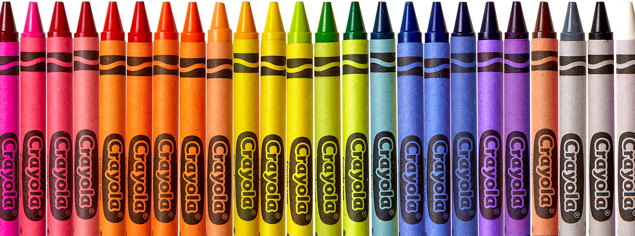
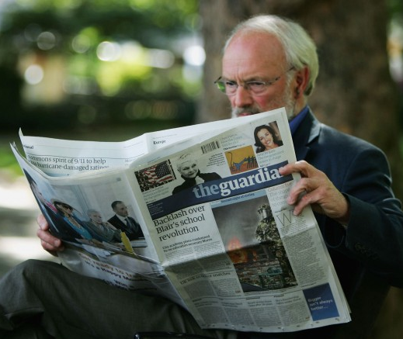
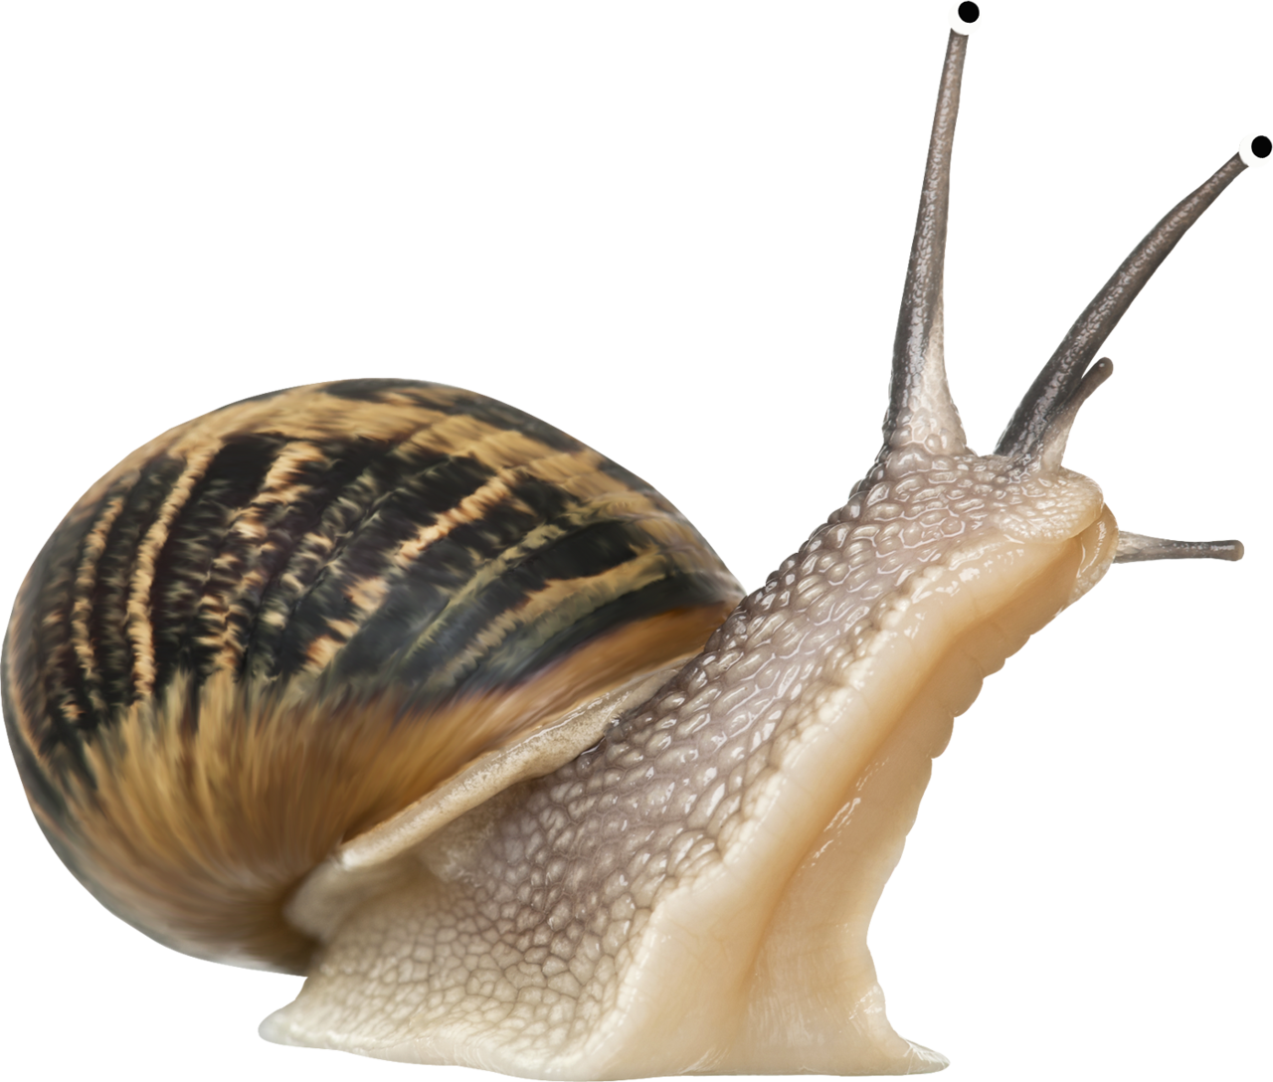
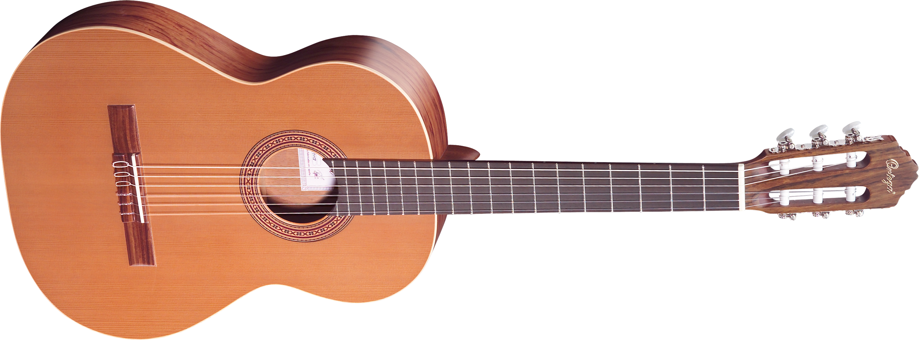
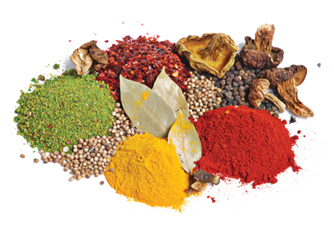
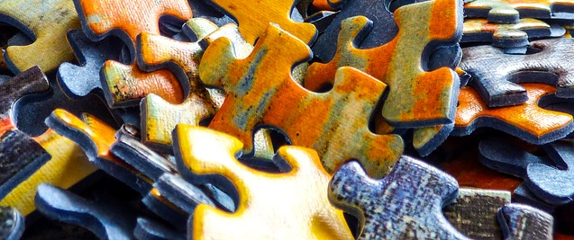
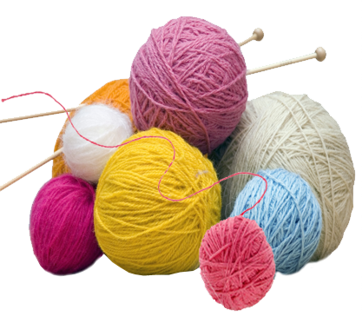
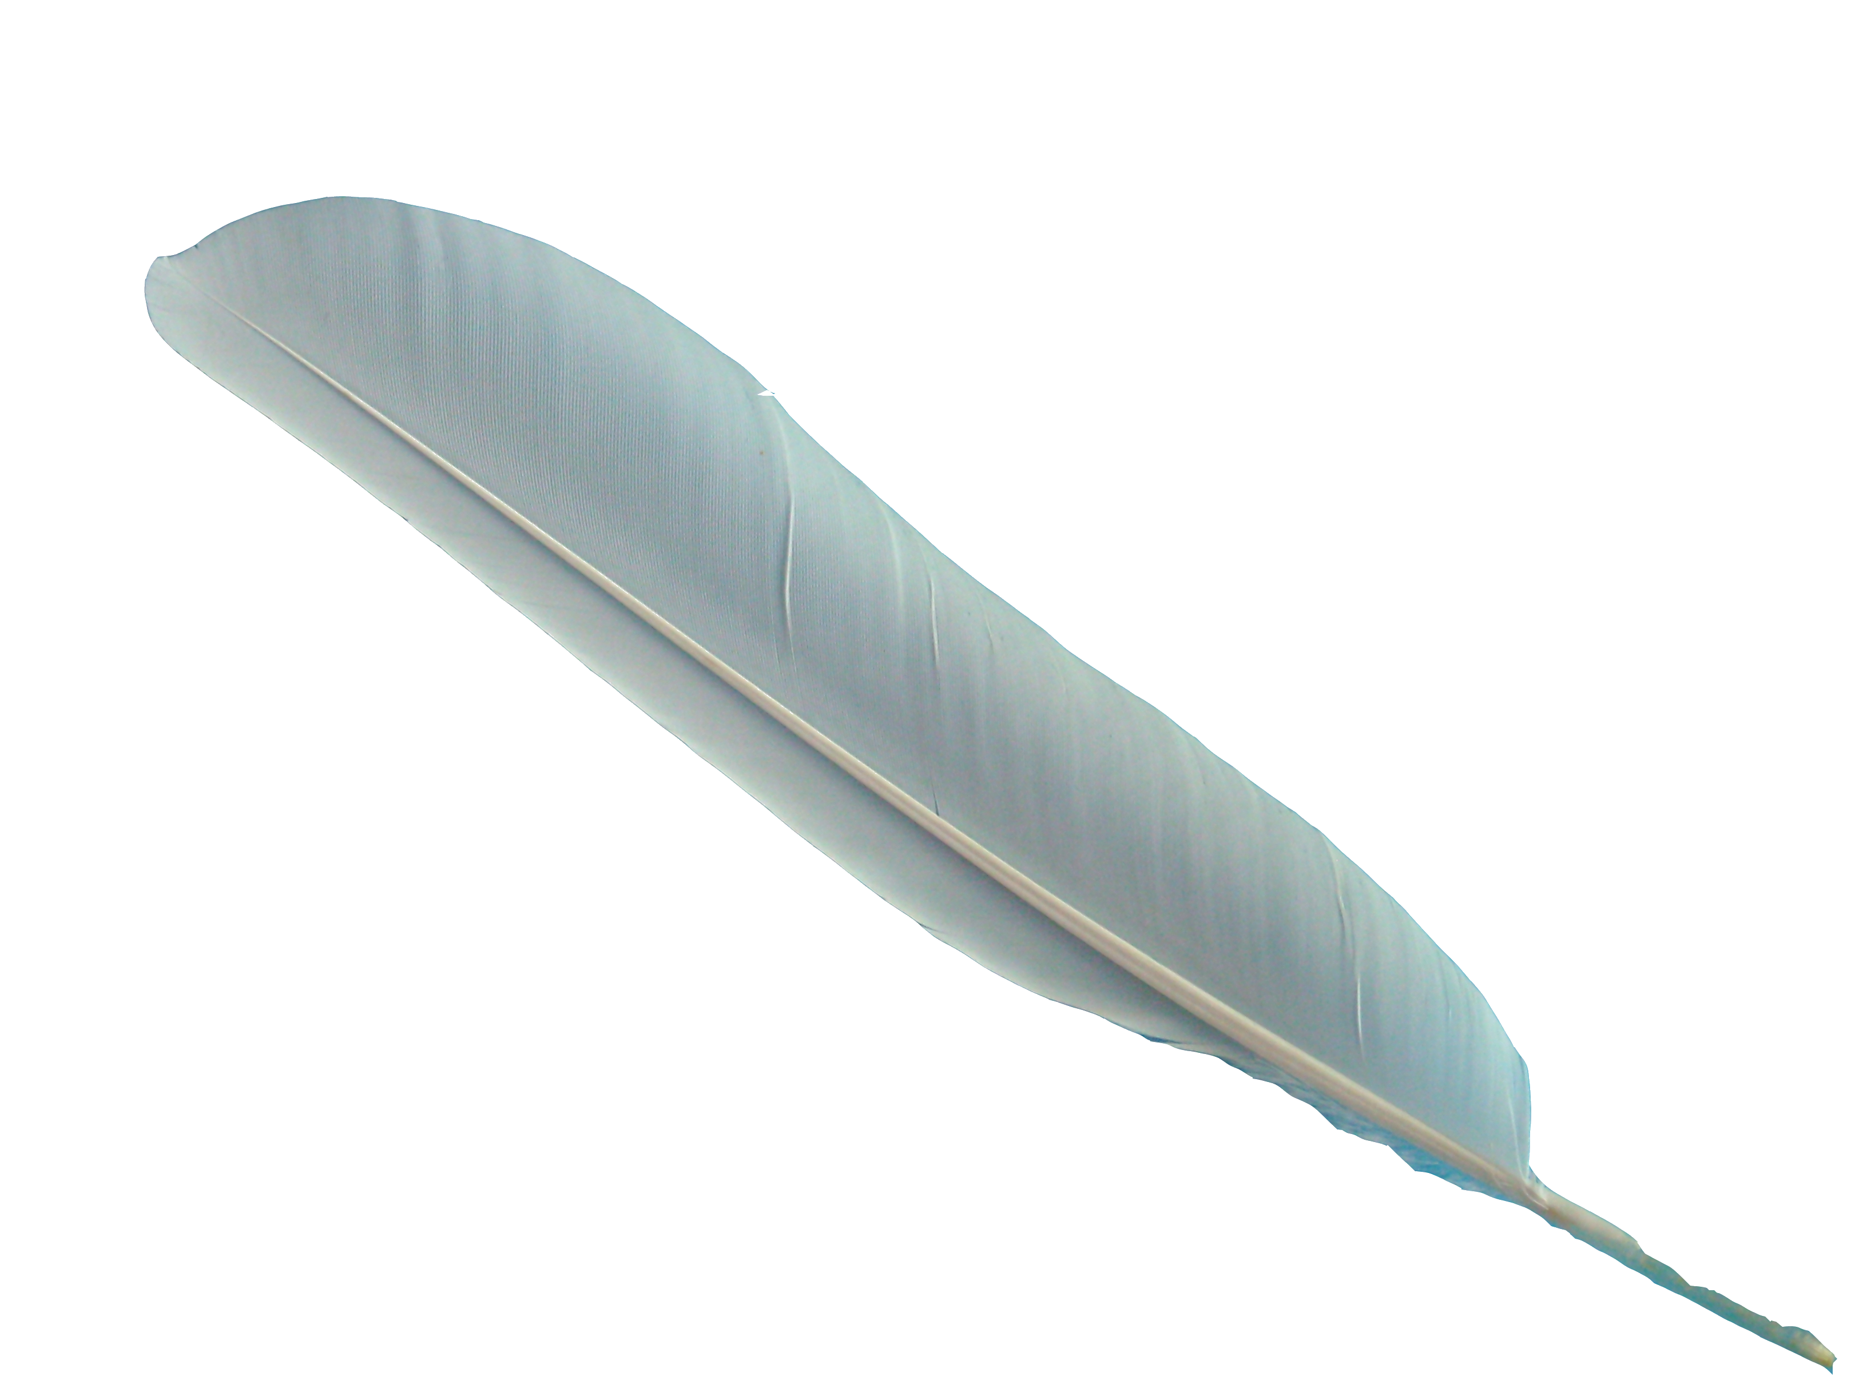
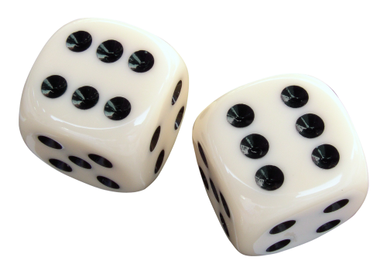
You can use whatever to train memory

Slide 39
MEMORY TRAINING FOR THE ELDERLY
Mgr. Věra Suchomelová, Th.D
v.suchomelova@centrum.cz

